Slide 1

Integrated Smart Irrigation & Crop Disease Prediction System
Team name : Abhi,
Hackathon name : Whack hack 4.0,
Participant name : Abhinav Harish

Slide 2
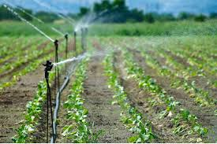
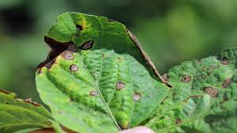
Problem Statement
Farmers make two difficult decisions daily:
How much water should I give?
Is my crop getting sick?
Today they rely on:
Guesswork
Experience
Visible damage
By the time damage appears → loss already happened

Slide 3
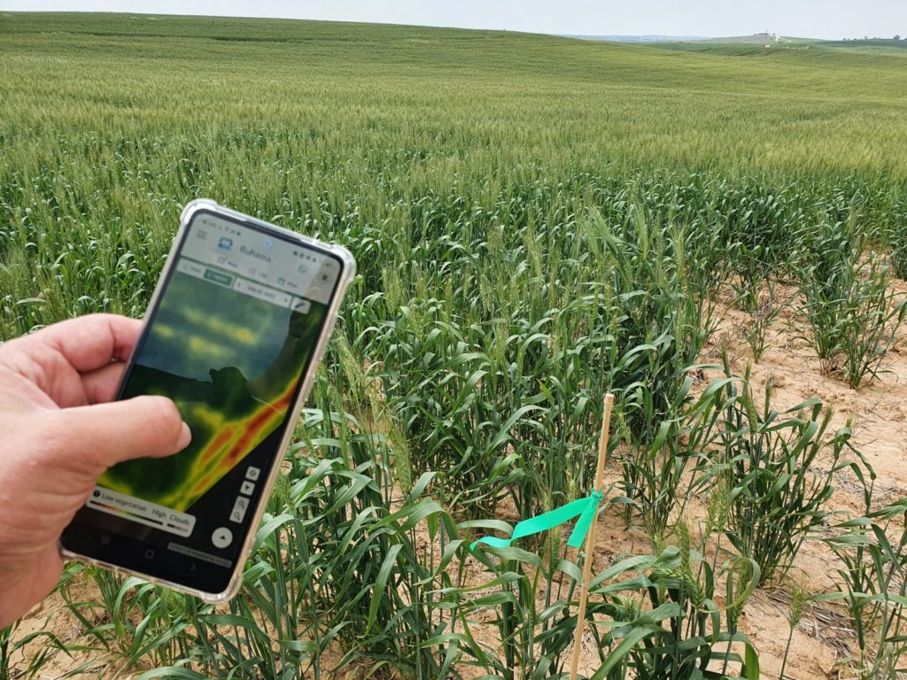
Proposed Solution
A simple mobile-friendly system that tells the farmer:
“Give this much water today.” “Your plant has this disease.”
No lab tests No expert required Just sensors + camera

Slide 4
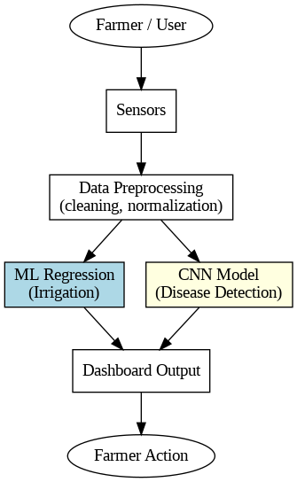
How It Works
Soil & weather data → system predicts water requirement
Farmer clicks leaf photo → system detects disease
Dashboard gives clear recommendation

Slide 5
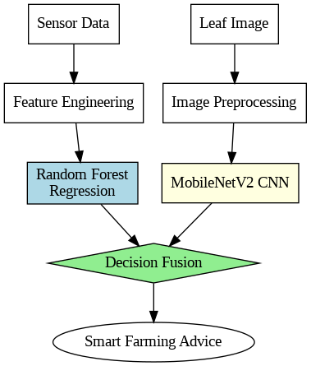
Models Implemented
ML: Random Forest Regression for irrigation prediction
DL: Transfer learning with MobileNetV2 for disease detection
Combined → gives final advice to farmer

Slide 6
Datasets used
Inputs:
Soil moisture
Temperature
Humidity
Rainfall
Crop image
Output:
Exact irrigation amount
Disease name + confidence

Slide 7
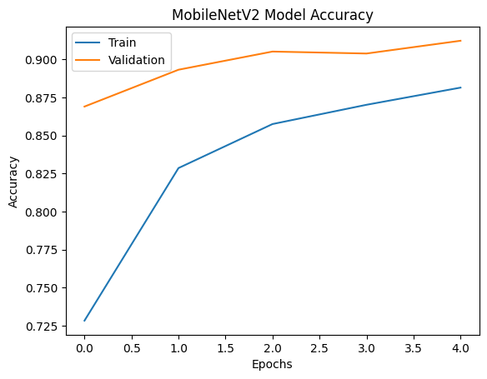
Results
Detects disease at early stage
Prevents over-watering
Prevents under-watering
Easy to use interface
Result → healthier crops + less resource waste

Slide 8
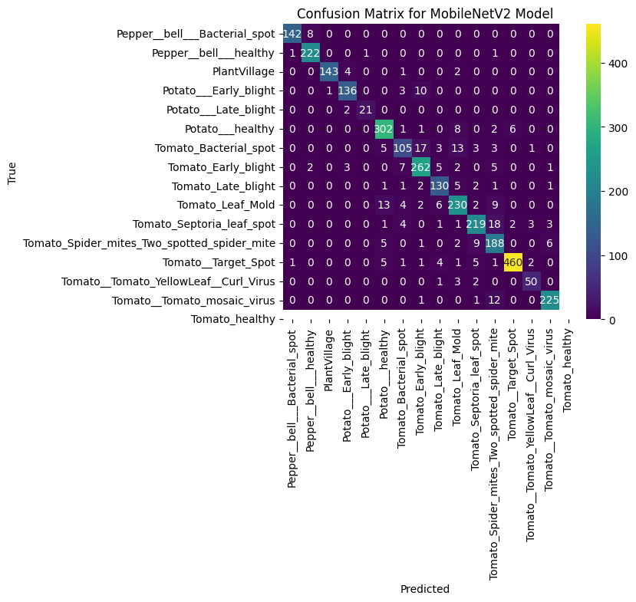
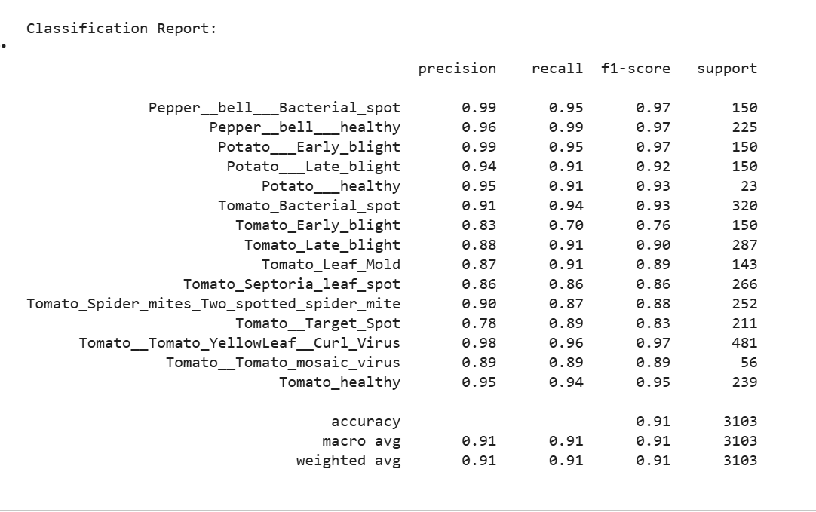

Slide 9
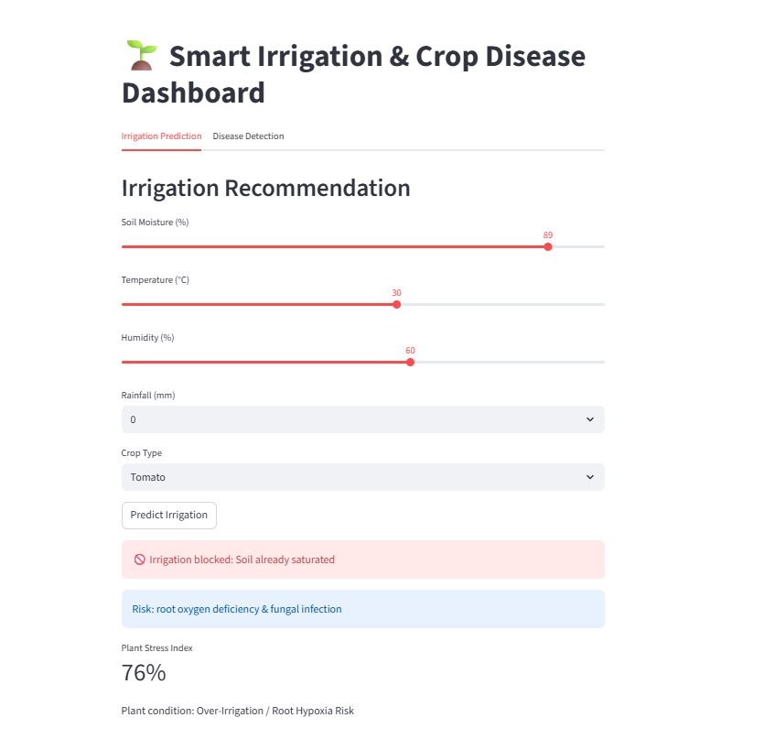
Virtual IoT Simulator
Farmer can:
Enter farm conditions
Upload leaf photo
Instantly get guidance
Designed for non-technical users also.

Slide 10
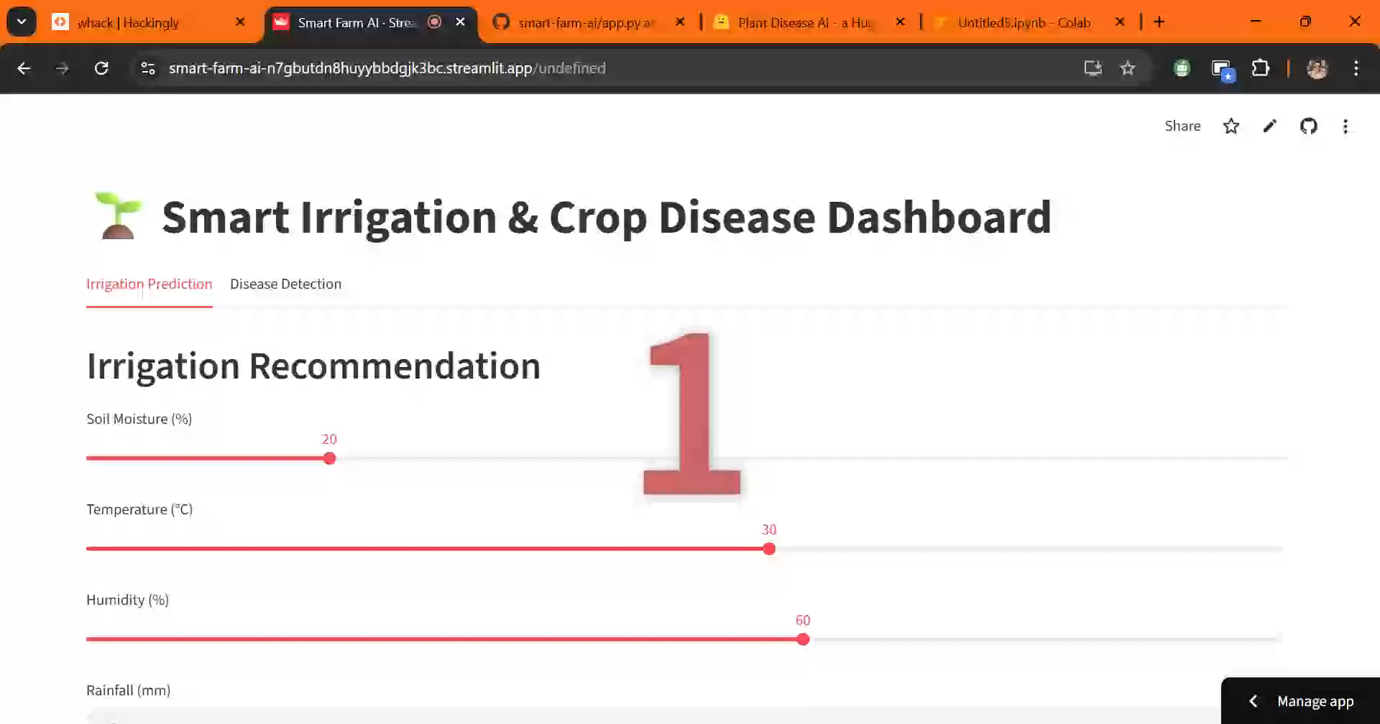
Demo Video

Slide 11
Real-World Impact
Saves water
Reduces pesticide usage
Increases yield
Affordable for small farmers
Technology serving agriculture

Slide 12
Conclusion
Hybrid AI system successfully integrates ML + DL
Dashboard ready for demo and farmer use
Strong performance validated with ROC and accuracy plots
Farmers don’t need complex technology
They need clear answers
SmartFarm AI turns agricultural data into simple daily decisions

Slide 13
THANK YOU
Contact Details :- Abhinav Harish
Team Abhi
abhinavharish104@gmail.com

